Slide 1
Continuous Armed Bandit
Kohei Watanabe (Intern), Bin Yang (Mentor)
Intelligence domain
RIT Department

Slide 2


Self-Introduction
Kohei Watanabe
2nd year Master Student
Internship Period: 6/22 ~ 9/8 (3 or 4 days a week)
My Lab: Harada-Ushiku Lab (MIL) @Tokyo Univ.
Computer Vision, Machine-Learning…etc
WebDNN[1] is useful when you want to make a demo using deep learning!
[1] https://mil-tokyo.github.io/webdnn/ja/
Notes:
Web DNN

Slide 3
Motivation
Designing next experiment based on the results of past experiments efficiently is valuable
especially when experiment cost is high
Where is tumor?
How many layers, neurons?
Hyperparameter tuning
Tumor Localization[1]
[1] Tumor Localization using Automated Palpation with Gaussian Process Adaptive Sampling, Garg et.al, CASE2016

Slide 4
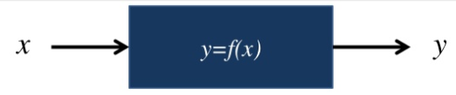
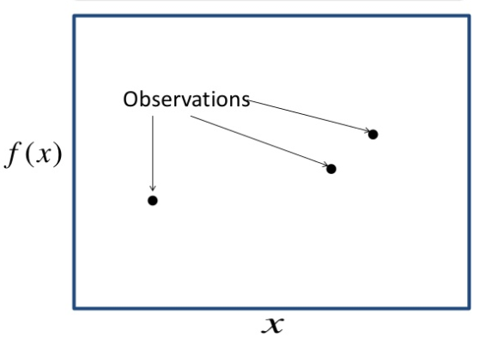
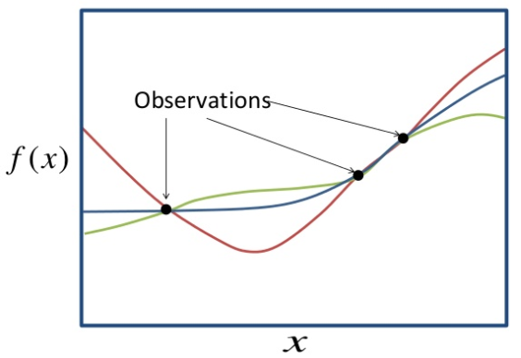
Problem Definition
Find the best parameter of Black Box function from observed and
Parameter
Performance
Input
Output (curve line)
Which curve line describes well?

Slide 5
Approach
Random Search, Grid Search
Low computation cost, but inefficient
Sequential Model-based Algorithm Configuration (SMAC)
Sequential Model-Based Optimization (SMBO): Bayesian optimization
Tree-Structured Parzen Estimator (TPE)
Implemented in “Hyperopt”
[Base] Gaussian Process Upper Confidence Bounce (GP-UCB)
Many open source (python) libraries (“Gpyopt”, “RoBo”, …)
[Ours] Gaussian Markov Random Field UCB (GMRF-UCB)
Not so popular(?), No library

Slide 6
Approach
Random Search, Grid Search
Low computation cost, but inefficient
Sequential Model-based Algorithm Configuration (SMAC)
Sequential Model-Based Optimization (SMBO): Bayesian optimization
Tree-Structured Parzen Estimator (TPE)
Implemented in “Hyperopt”
[Base] Gaussian Process Upper Confidence Bounce (GP-UCB)
Many open source (python) libraries (“Gpyopt”, “RoBo”, …)
[Ours] Gaussian Markov Random Field UCB (GMRF-UCB)
Not so popular(?), No library

Slide 7
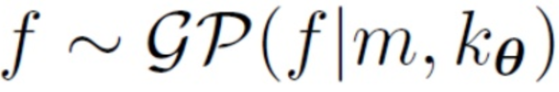
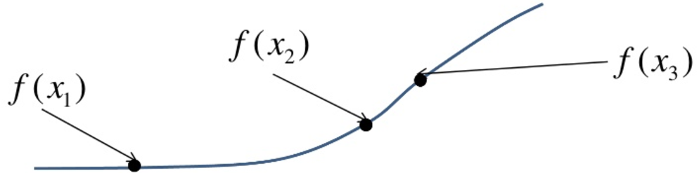
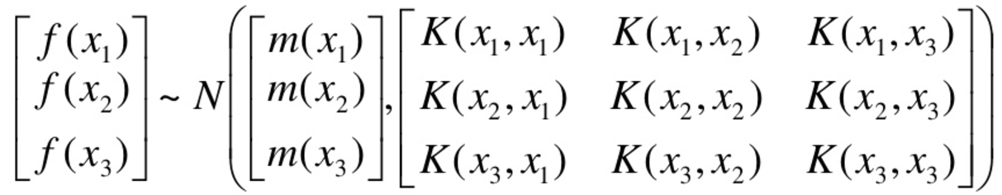
GP-UCB: What is GP?
Gaussian Process
Every point in some continuous input space is associated with a normally distributed random variable
“Kernel”
Distance between two points
e.g.) Gaussian Kernel
“Mean”

Slide 8
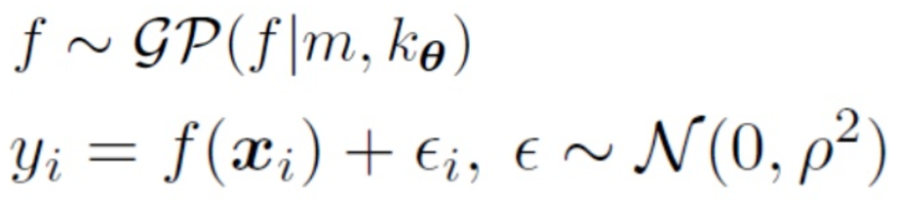
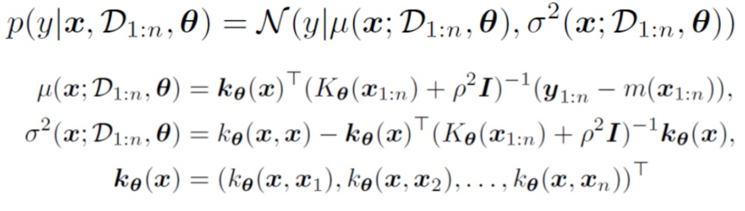
GP-UCB: How does GP predict?
Generation Process
Bayesian Predicted Distribution

Slide 9
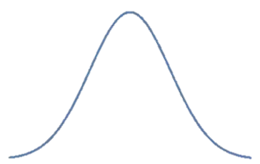
GP-UCB: What is UCB (Upper Confidence Bound) ?
Next Sampling point
Notes:
Add more info

Slide 10
GMRF-UCB: Introduction
Split the continuous space to discrete one
Considering that the adjacent point has relation with each other, Simply model this, introducing hidden nodes!
The joint probability can be calculated as follows;
: the connection strength between and
: the connection strength between and
Hidden node
Observed node

Slide 11
GMRF-UCB: How to model
Let’s make this model more sophisticated
The joint probability can be calculated as follows;
: the connection strength between and
: the connection strength between and
Hidden node
Observed node
Two Points of Modification
should have prior Gaussian distribution
The number of would be plural ( should be replaced to )
①
②
Removed
Index
to simplify
Real
Simple

Slide 12
GMRF-UCB: How to model
Let’s make this model more sophisticated
The joint probability can be calculated as follows;
: the connection strength between and
: the connection strength between and
Hidden node
Observed node
Combining these….
①
②
Removed
Index
to simplify
Real
Simple

Slide 13
GMRF-UCB: How to model
Final GMRF can be calculated as follows;

Slide 14
GMRF-UCB: How to model
Final GMRF can be calculated as follows;

Slide 15
GMRF-UCB: How to model
Final GMRF can be calculated as follows;
Why A’ is used instead of A?

Slide 16
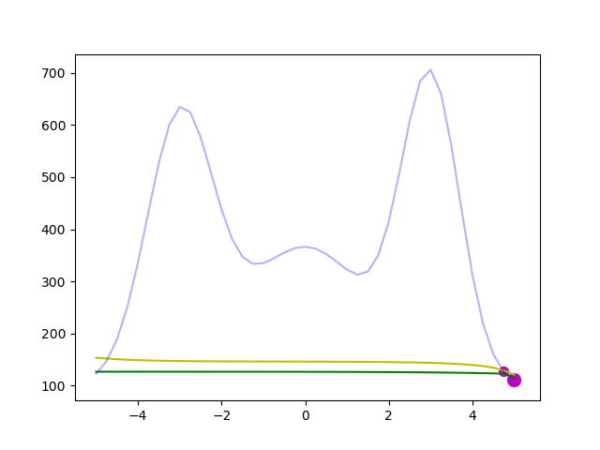
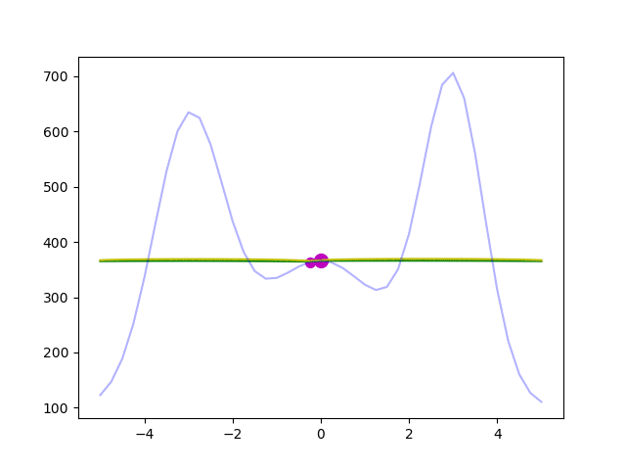
GMRF-UCB: How to model
Comparison between A and A’
Delete A
Ground Truth
Predicted Mean
Predicted UCB
If A is used, edge points are easier to be selected than center points

Slide 17
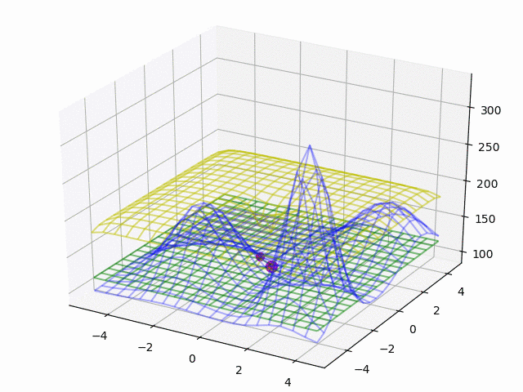
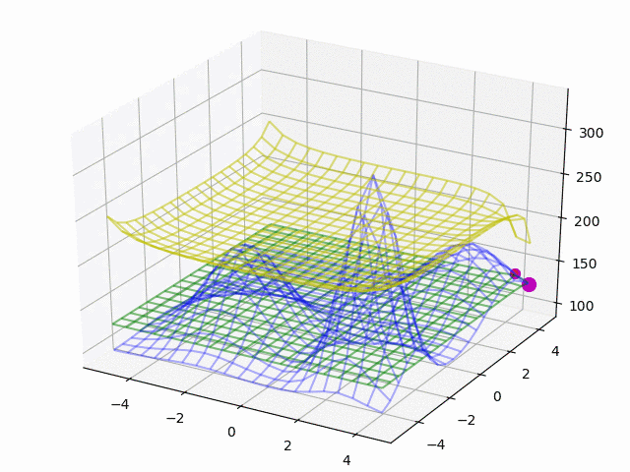
GMRF-UCB: How to model
Comparison between A and A’
Ground Truth
Predicted Mean
Predicted UCB
If A is used, edge points are easier to be selected than center points

Slide 18
Acquisition Functions except UCB
Actually UCB is just one solution. The others are
Thompson Sampling (TS) :
Just sampling. Performance is good, but computation is heavy…
Probability Improvement (PI):
PI is said to be too greedy.
Expected Improvement (EI):
EI seems to be the most popular. (In most libraries, default setting is EI)

Slide 19
Experiment

Slide 20
GMRF-UCB: Before Experiment…
How should hyperparamters of GMRF should be set?
GP Libraries often sample some points (known as “burnin”) and estimate its hyperparamters by optimizing the log-marginal-likelihood (or MCMC)
But this didn’t work well in GMRF☹
In our many experiments, we found that these worked well
Normalizing output (mean0var1 or min0max1)
Pairwise-sampling, then estimate and the other hyperparameters
Grid-based burn-in

Slide 21
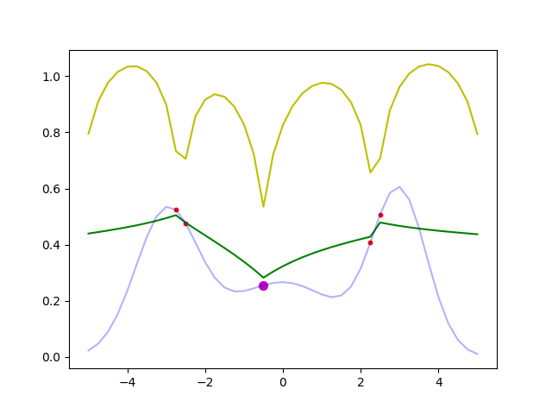
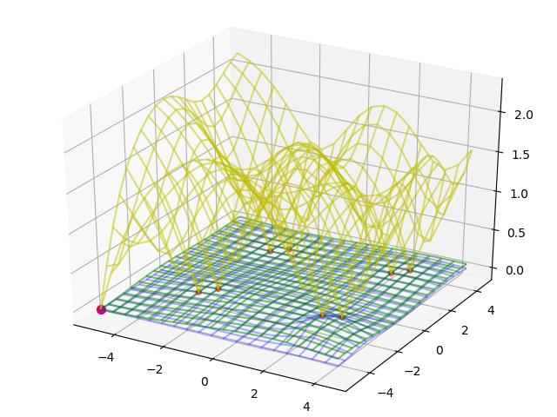
GMRF-UCB: Before Experiment…
How should hyperparamters of GMRF should be set?
GP Libraries often sample some points (known as “burnin”) and estimate its hyperparamters by optimizing the log-marginal-likelihood (or MCMC)
But this didn’t work well in GMRF☹
In our many experiments, we found that these worked well
Normalizing output (mean0var1 or min0max1)
Pairwise-sampling, then estimate and the other hyperparameters
Grid-based burn-in
Sampling center 2*d points as burn-in

Slide 22
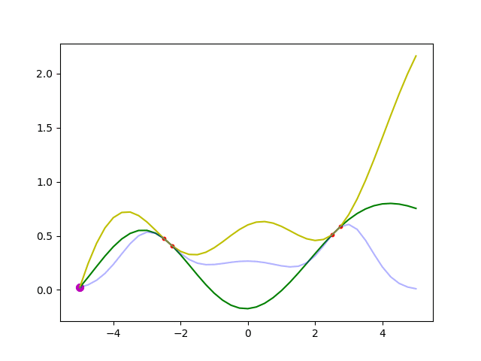
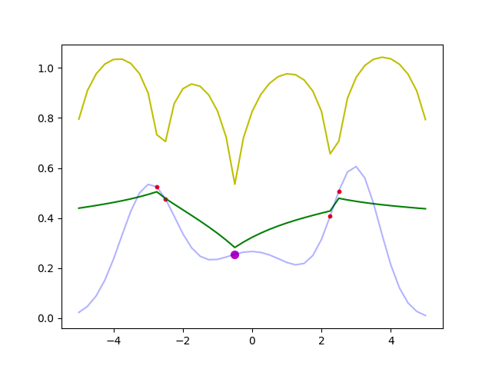
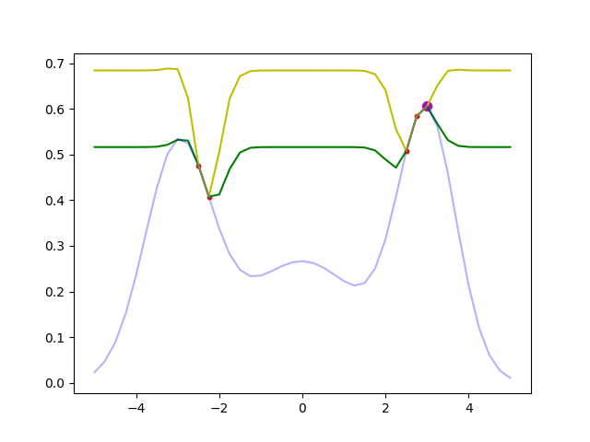
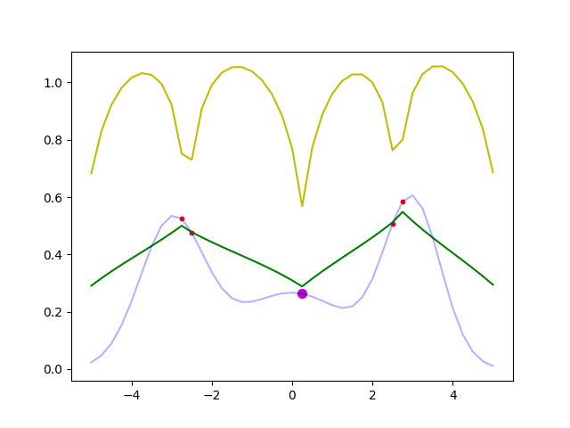
Result: Comparison between GP-UCB and GMRF-UCB
The performance of GP is affected by its Kernel hyperparamter
GP
GMRF
Fixed Kernel
Mean0-Var1 Normalization
Ground Truth
Predicted Mean
Predicted UCB
Unfixed Kernel
Min0-Max1 Normalization

Slide 23
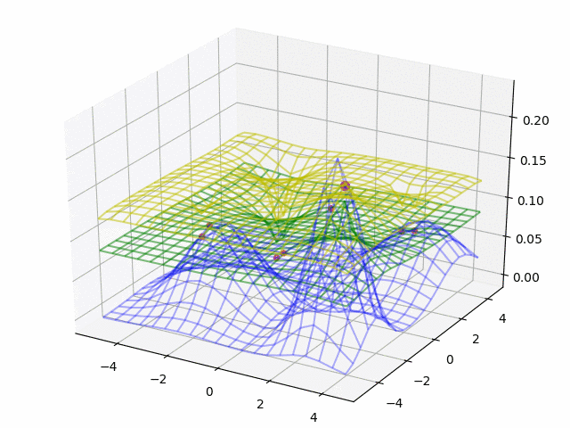
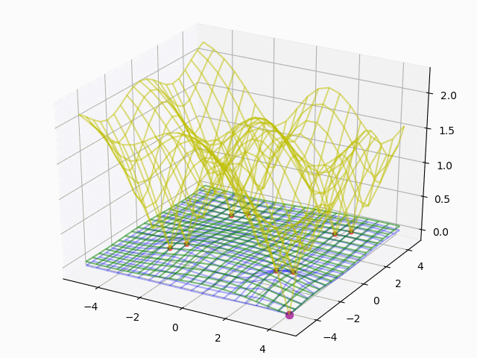
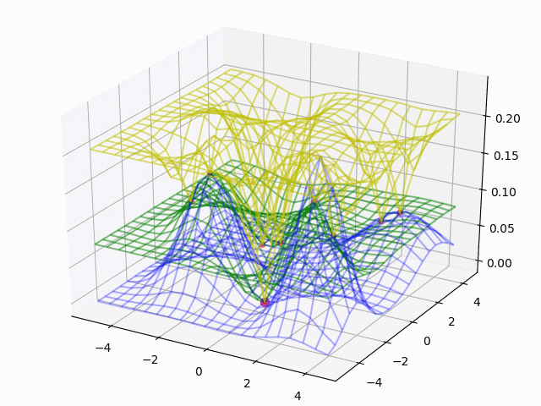
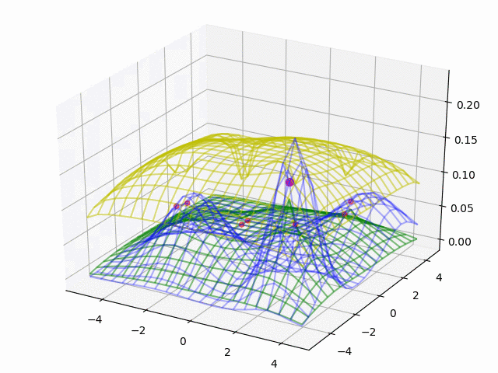
Result: Comparison between GP-UCB and GMRF-UCB
The performance of GP is affected by its Kernel hyperparamter
GP
GMRF
Fixed Kernel
Mean0-Var1 Normalization
Ground Truth
Predicted Mean
Predicted UCB
Unfixed Kernel
Min0-Max1 Normalization

Slide 24
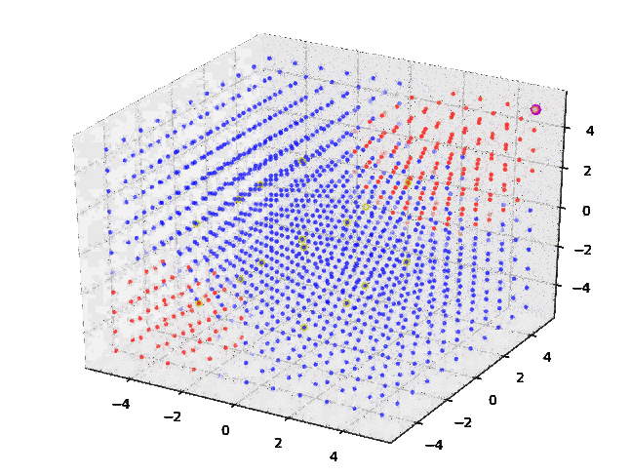
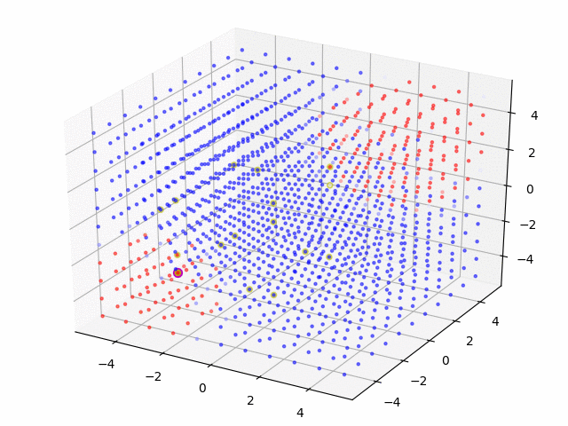
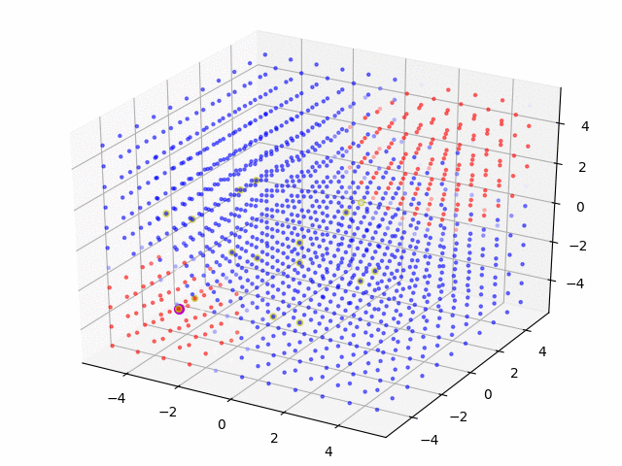


Result: Comparison between GP-UCB and GMRF-UCB
The performance of GP is affected by its Kernel hyperparamter
GP
GMRF
Fixed Kernel
Mean0-Var1 Normalization
High
Low
Unfixed Kernel
Min0-Max1 Normalization

Slide 25
Pros and Cons between GP and GMRF
 | GP | GMRF
Continuous Space | ○ | ×
Memory Efficiency (The number of parameters) | Linearly Increasing | Constant
Difficulty of hyperparameter tuning | ○ or △(Not so stable) | △ (pairwise sampling is not so good☹)
Extensibility | △ (Most implementation considers the number of samples per point is only one) | ○ (My implementation considers the number of samples per point can be many)
https://github.com/scikit-learn/scikit-learn/issues/3162

Slide 26
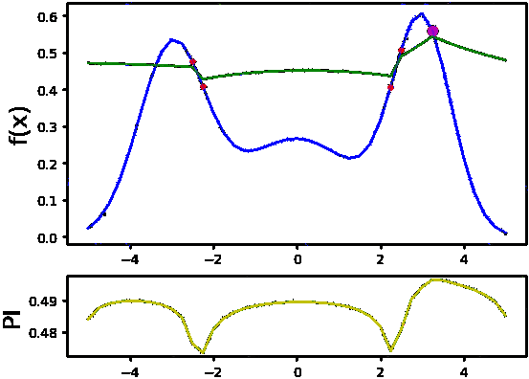
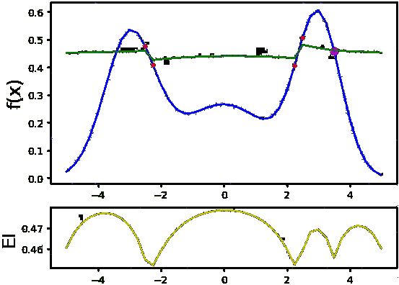
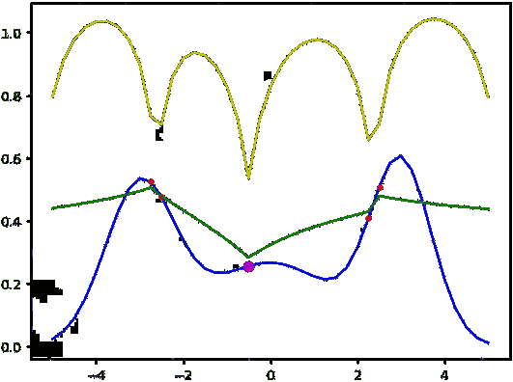
Result: Comparison of different acquisition functions (GMRF)
UCB
PI
EI
Ground Truth
Predicted Mean
Predicted Acq.

Slide 27
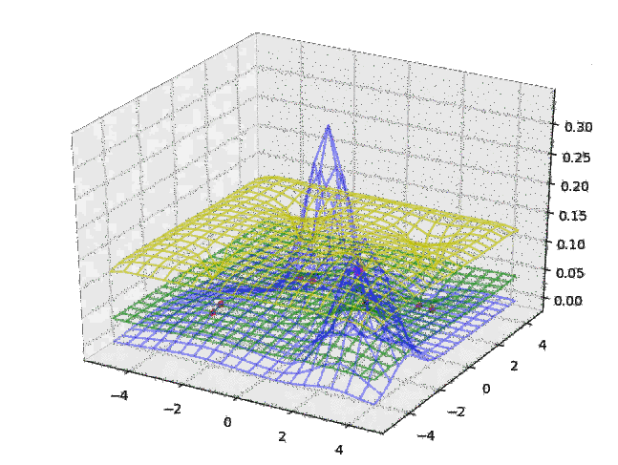
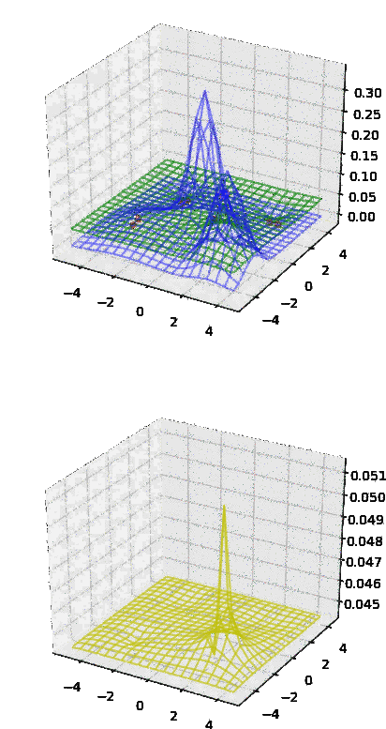
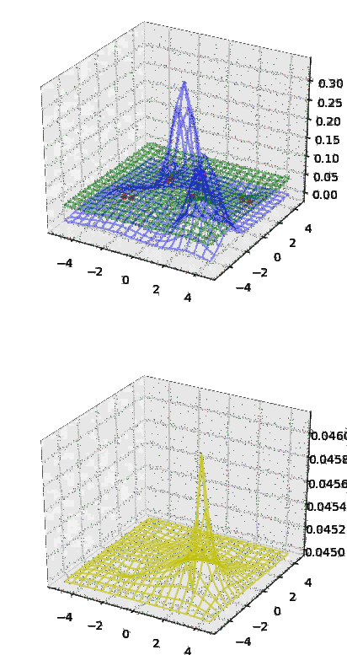
Result: Comparison of different acquisition functions (GMRF)
UCB
PI
EI
Ground Truth
Predicted Mean
Predicted Acq.

Slide 28
Idea of GMRF Application to improve CTR

Slide 29
Apply GMRF to Improve CTR
So far, we sampled just one(or a few) time(s) per point.
When we tune the hyper-parameter of some ML (e.g. Recommendation) engine for improving CTR, the number of samples per point are quite many.
In order to apply GMRF,
CTR data can be converted to real value using logit function.
 | Visit | Click
Point20 | 1000 | 123
Point21 | 1000 | 99
Point09 | 1000 | 876
... | ... | ...
 | Visit | Val
Point20 | 1000 | -1.964
Point21 | 1000 | -2.208
Point09 | 1000 | 6.906
... | ... | ...

Slide 30
Apply GMRF to Improve CTR
 | Visit | Click
Point20 | 1000 | 123
Point21 | 1000 | 99
Point09 | 1000 | 876
... | ... | ...
 | μ | σ
Point01 | 0.021 | 3.5e-5
Point02 | 0.014 | 5.1e-5
Point03 | -0.013 | 8.7e-6
... | ... | ...
GMRF
CTR Experiment
 | Visit | Click
Point01 | 1500 | ?
Point02 | 3000 | ?
Point03 | 4000 | ?
... | ... | ...
Total Click
Generate probability
per point
MB Bandit

Slide 31
Future Work
Dynamic

Slide 32
References
ベイズ的最適化(Bayesian Optimization)の入門とその応用
https://www.slideshare.net/issei_sato/bayesian-optimization

Slide 33
Not Finished
Supplemental

Slide 34
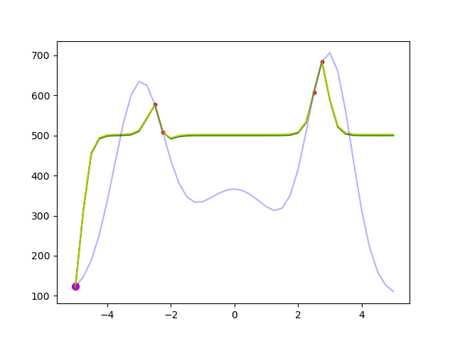
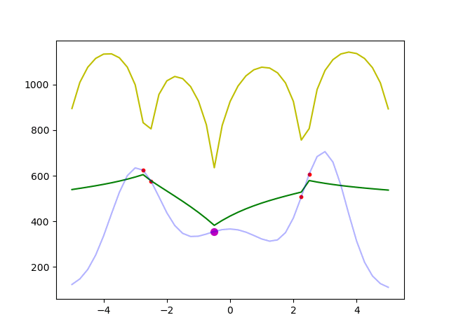
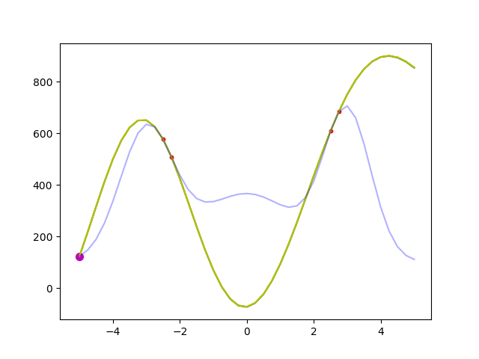
[BigYscale]Result: Comparison between GP and GMRF
The performance of GP is affected by its Kernel hyperparamter

